Slide 1



Cover Page
Monday, 06 Oct 2025
PROJ703/ PROJ903 International Challenge Project “Eurobot”
By
ROBO-UN
Page-01

Slide 2
Table of Content
Simulation -03
Mechanics -04
Electronics -05
Roadmap -06
Motivation -07
Page - 02

Slide 3
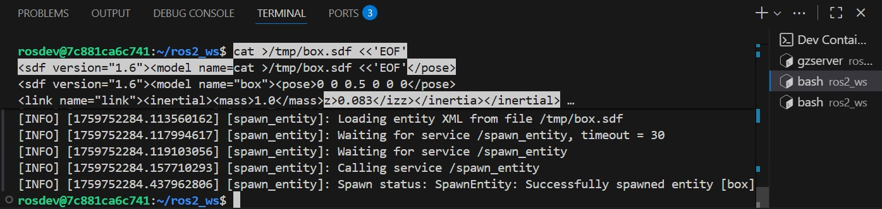
SIMULATION
Installation of the necessary programs.
Difficulties installing ROS2+Headless Gazebo and getting it to run.
For next week: Start simulating basic movements on the actual map
Page - 03

Slide 4
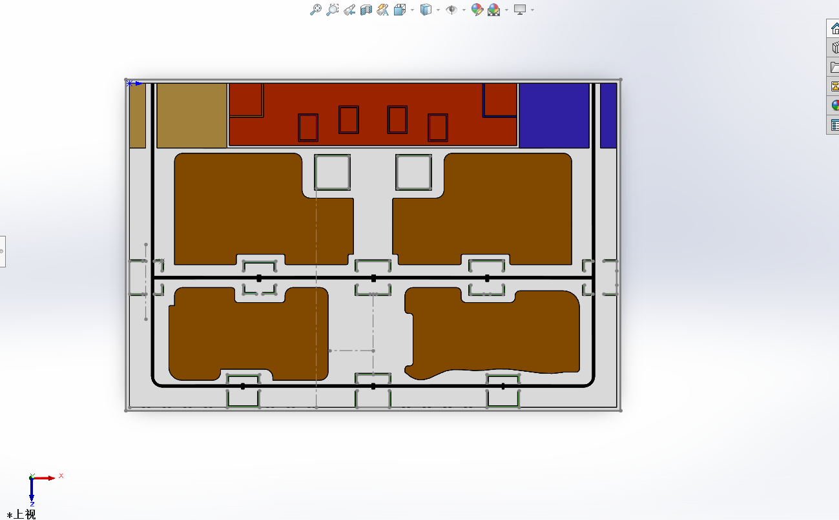
MECHANICS
1.Precise dimensions
2.corresponding colour
3.STL. for simulation
and SWpart. for changing
Page - 04

Slide 5
ELECTRONICS
1- Lipo 4S Battery
2- Microcontroller (Teensy 4.1)
3- On-board Computer (Raspberry Pi)
4- Sensors (IMU 9 axis, TOF, Global shutter Camera)
5- Actuators (DC motors with encoders, Servos)
6- Emergency Stop switch, Fuses, BMS
Page - 05

Slide 6
ROADMAP
Electronics-first co-design: motor/driver/power choices define mechanical envelopes (then freeze them).
Gazebo-first: simulate the full match flow before machining/printing.
Modular mechanics (DfMA): quick-swap subsystems quick-swap subsystems , easy service, minimal part/fastener variety.
Simple → layered: deliver a reliable MVP now ; add features only after gate KPIs are green.
Timeline: September 2025 → mid-January 2026, with weekly deliverables.
Sustainability (3R): reduce, reuse, recycle ; prefer local/EU sourcing .
Work to roles: follow our Task Distribution
Page - 06

Slide 7
HOW DO WE KEEP MOTIVATION HIGH?
Structure and project management
Team Culture & Morale
Goals, Rewards and Milestones
Learning and Development
Maintaining energy and preventing burnout
The Final Strech: Pre-competition focus
Page - 07

